Slide 1
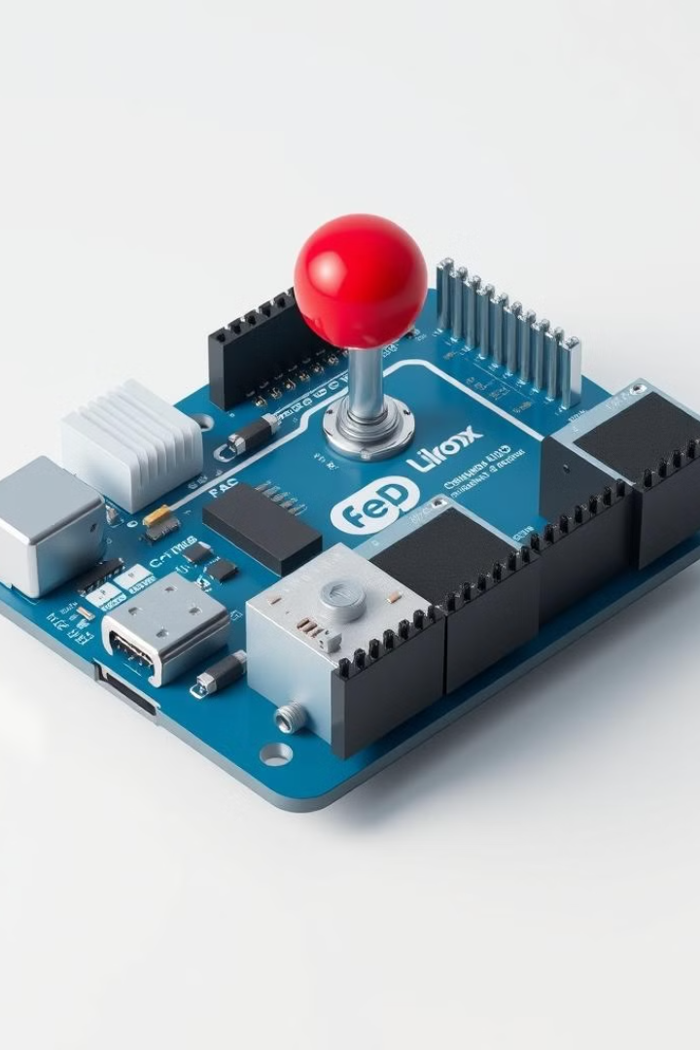
Joystick Driven Steering Control Using Arduino
This project explores the integration of a joystick and an Arduino Uno to create a dynamic steering control system for various applications, such as robotics and remote-controlled vehicles.
TEAM MEMBERS
Adyan- 22BMH1093
Mohammed Safwan- 22BMH1105
H Ashish- 22BMH1115

Slide 2

Contents of the Presentation
Slide No.
Heading
1
Title, Reg. No, and Project Members
2
Contents of the Presentation
3
Introduction to Joystick Driven Steering Control Using Arduino
4
Problem Definition and Objectives
5
Block Diagram or Schematics
6
Bill of Materials
7, 8, 9
Working Explanation, Simulation, Source Code
10
Hardware Model
11
Outcome of the project
12
Conclusion

Slide 3
Introduction to Joystick Driven Steering Control Using Arduino
1
Seamless Integration of Joystick and Arduino
2
Diverse Applications
3
Real-Time Responsiveness
The developed system can be utilized in various applications, including robotics, remote-controlled vehicles, and automation, where precise and dynamic steering control is required.
The project focuses on creating a system that responds in real-time to the user's input, providing smooth and accurate steering control.
The project aims to leverage the Arduino Uno's processing capabilities and the intuitive control of a joystick to create a versatile and user-friendly steering control system.
4
Enhanced Flexibility
5
Accessibility and User Experience
The modular design of the system allows for easy integration with different types of motors and driving mechanisms, making it adaptable to various project requirements.
The intuitive joystick interface ensures a seamless and user-friendly experience, making the system accessible to a wide range of users.

Slide 4

Problem Definition and Objectives
Problem Definition
Project Objectives
Developing a steering control system that can be easily integrated with various robotic and automation projects, providing precise and responsive control using a joystick interface.
Integrate a joystick module with an Arduino Uno for intuitive steering control
Design a control algorithm that translates joystick input into precise motor control commands
Ensure real-time responsiveness and smooth steering control
Develop a modular and flexible system that can be adapted to different motor configurations and project requirements
Create a user-friendly interface that enhances the overall experience for the end-user

Slide 5

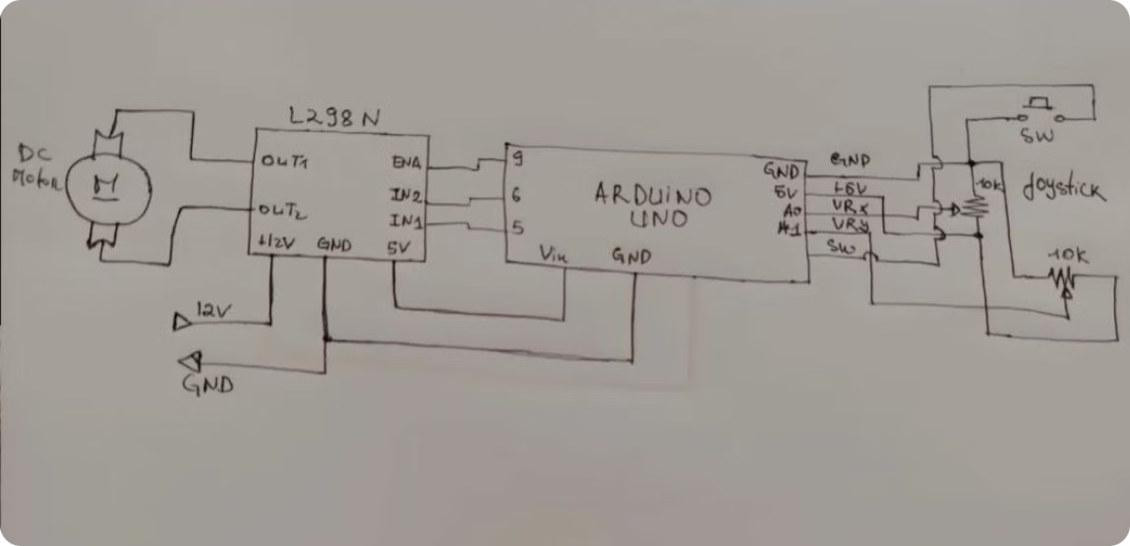
Block Diagram & Schematics
The block diagram or schematic illustrates the key components and their interconnections within the joystick-driven steering control system. The Arduino Uno acts as the central processing unit, receiving input from the joystick module and controlling the L298N motor driver, which in turn drives the DC motors with 20V supply which is responsible to control the steering mechanism.

Slide 6
Bill of Materials
Component
Quantity
Price
Joystick Module
1
100
L298N Motor Driver Module
1
100
DC Motor
2
200
Power Supply (Appropriate for the Motor)
1
-
Arduino Uno
1
750
Wires
As Needed
75
3D Printed Components
As Needed
1200
TOTAL
2,425
The bill of materials lists the key components required for the joystick-driven steering control system, including the Arduino Uno, joystick module, motor driver, DC motors, power supply, and other necessary accessories such as wires and 3D printed parts.

Slide 7



Working Explanation
Joystick Input
Arduino Processing
Motor Driver Control
The user manipulates the joystick, providing directional input to the system.
The Arduino Uno receives and processes the joystick input, converting it into appropriate motor control commands.
The Arduino sends control signals to the L298N motor driver, which in turn drives the DC motors to achieve the desired steering response.
The joystick-driven steering control system works by translating the user's input from the joystick into precise motor control commands. The Arduino Uno acts as the central processing unit, receiving the joystick data and processing it to generate the appropriate signals for the motor driver. The L298N motor driver then controls the DC motors responsible for the steering mechanism, ensuring a smooth and responsive steering control experience.

Slide 8

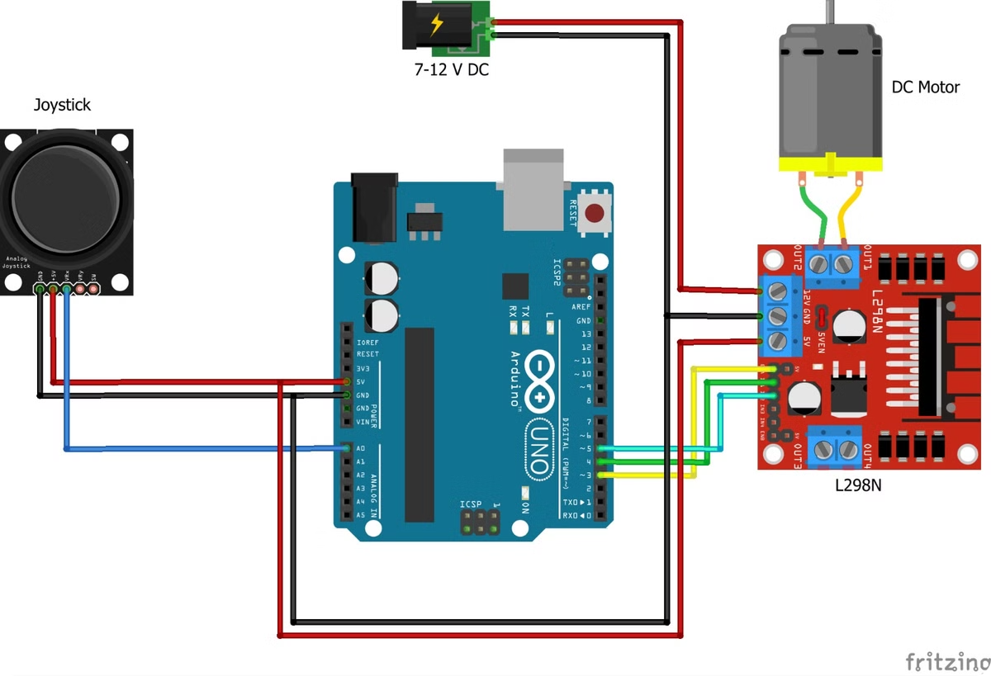
Simulation
To validate the design and functionality of the joystick-driven steering control system, a detailed simulation has been developed. This simulation allows for the visualization of the system's behavior, including the integration of the joystick input, the processing by the Arduino Uno, and the resulting control of the DC motors. The simulation helps to ensure the system's responsiveness, accuracy, and overall performance before the hardware implementation.

Slide 9
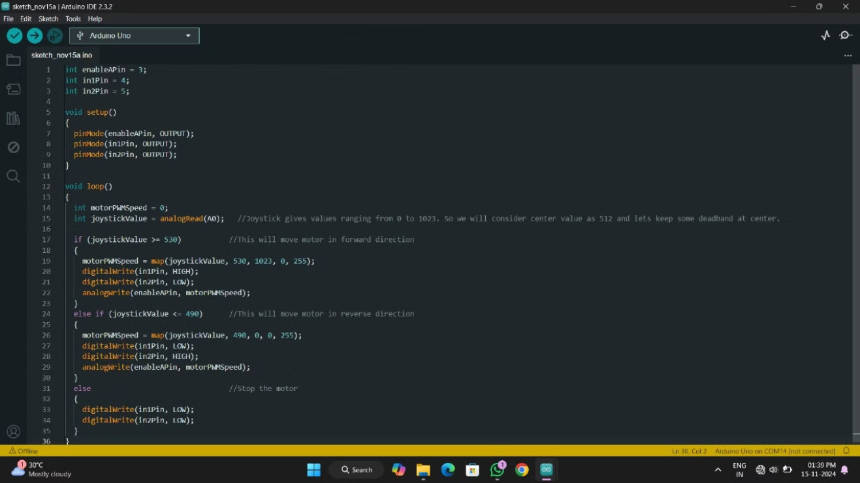
Source Code

Slide 10

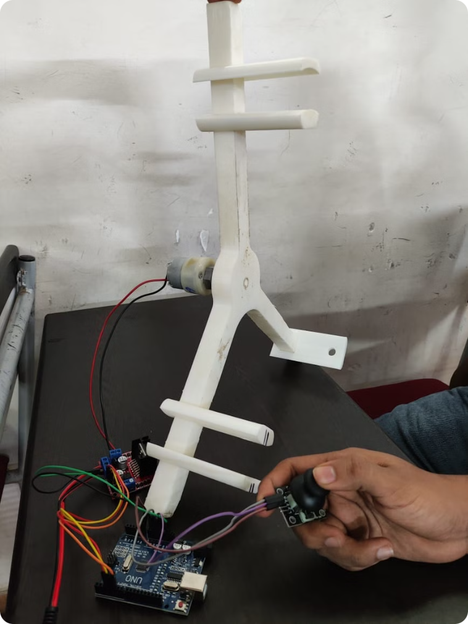
Hardware Model
The hardware model of the joystick-driven steering control system has been carefully constructed to bring the simulation to life. This physical implementation includes the Arduino Uno, the L298N motor driver, the DC motors, and various 3D printed components to create a robust and functional steering control system. The hardware model allows for real-world testing, troubleshooting, and refinement of the system, ensuring its reliability and effectiveness in practical applications.

Slide 11




Outcome of the Project
Precision Control
Flexible Integration
Enhanced Usability
Innovative Approach
The joystick-driven steering control system provides precise and responsive control, allowing for fine-tuned adjustments and seamless maneuvering of the target application.
The modular design of the system enables easy integration with a wide range of projects, making it a versatile solution for various robotic, automation, and remote-controlled applications.
The intuitive joystick interface and the system's real-time responsiveness provide users with a seamless and user-friendly experience, making the steering control system accessible and enjoyable to operate.
By combining the capabilities of the Arduino Uno and the intuitive control of a joystick, this project demonstrates a novel and innovative solution for steering control, paving the way for future advancements in the field.
The outcome of the joystick-driven steering control project is a versatile and user-friendly system that effectively integrates the Arduino Uno and a joystick module to provide precise, responsive, and flexible steering control. The project's key achievements include precision control, flexible integration, enhanced usability, and an innovative approach that can be applied to a wide range of robotic, automation, and remote-controlled applications.

Slide 12

Conclusion
The joystick-driven steering control project has successfully demonstrated the seamless integration of an Arduino Uno and a joystick module to create a versatile and user-friendly steering control system. By leveraging the processing capabilities of the Arduino and the intuitive control of the joystick, the project has achieved precise and responsive steering control, making it a valuable solution for various applications in the fields of robotics, automation, and remote-controlled vehicles. The modular design and the focus on enhancing the user experience have further expanded the system's adaptability and accessibility, paving the way for future advancements and innovative applications in the field of steering control technology.

